Slide 1

Assignment 1 Group 8
Text classification

Slide 2
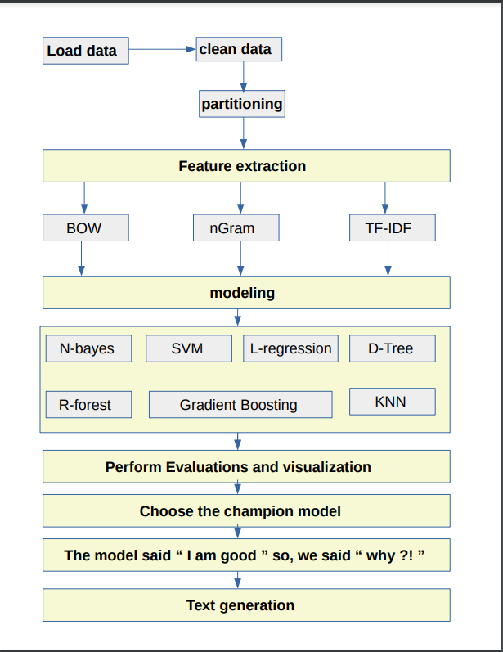
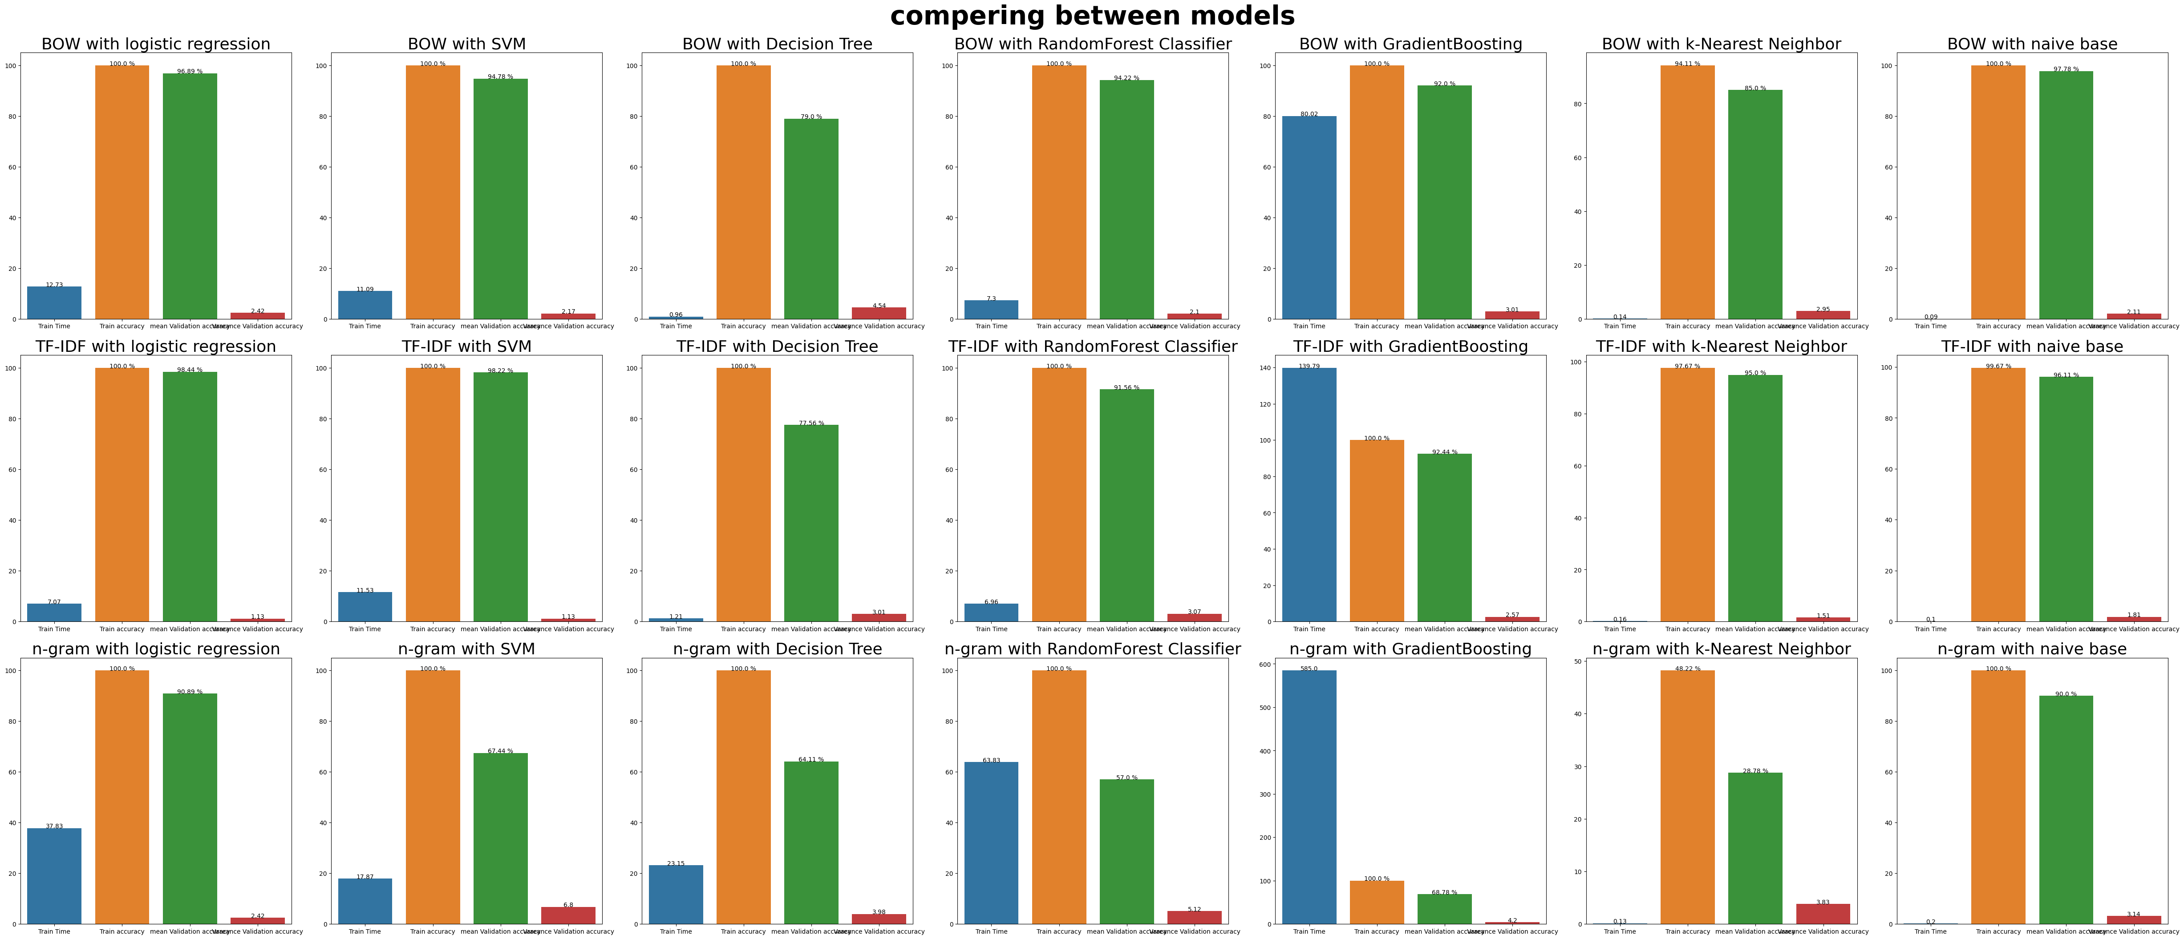
Pipeline overview Models Results

Slide 3
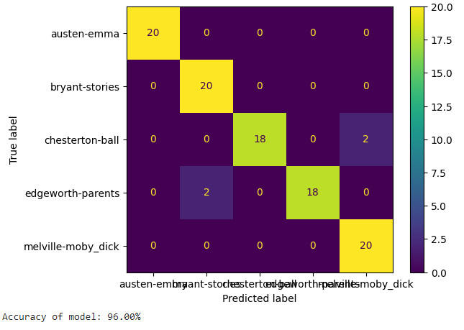
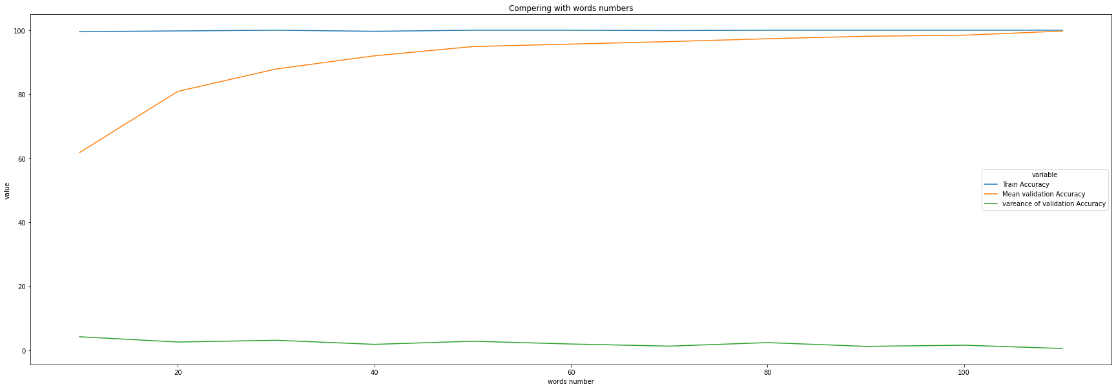
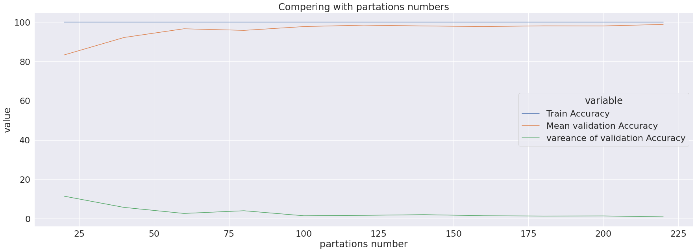
Champion evaluation Text generation
After Text Generation
Training using TF-IDF and logistic regression
Apply cross-validation with 10 folds.
************************************
Train accuracy: 98.666666666667%
Mean of accuracies: 64.4444444444%
Test accuracy: 76.0%

Slide 4

Thank You
Group 8 Members
1-Eslam Abdelraheem
2-Amjad Dife
3-Omar Ashraf
4-Mohamed Bekheet

